Slide 1
NHLBI
Deep Learning Crash Course
National Heart, Lung, and Blood Institute
Fall 2021

Slide 2
Outline
CNN basics
Variation of convolution
Batch Normalization
CNN for classification

Slide 3
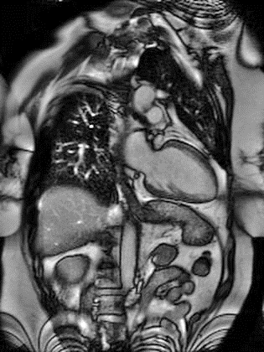
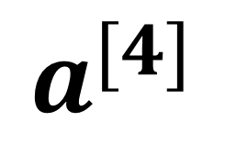
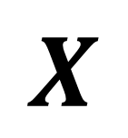
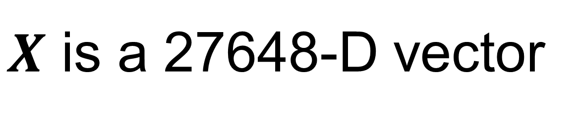
Revisit image classification
W₁^{[1]}
f
W₁^{[2]}
f
W₁^{[3]}
f
… …
… …
… …
flatten
… …
$$X$$
… …
… …
… …
W_{k}^{[1]}
f
W_{k}^{[2]}
f
W_{k}^{[3]}
f
W₁^{[4]}
f
$$a^{[4]}$$
… …
192x144x1
… …
… …
… …
#parameter?
2,764,800+100
~2.8million …
W_{N}^{[1]}
f
W_{N}^{[2]}
f
W_{N}^{[3]}
f
$X$ is a 27648-D vector
For N=100, first weight matrix has the dimension of 100x27648

Slide 4

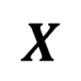
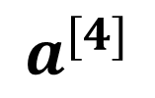
Revisit image classification
red
green
W₁^{[1]}
f
W₁^{[2]}
f
W₁^{[3]}
f
… …
… …
… …
… …
$$X$$
… …
f
… …
f
… …
f
f
W_{k}^{[1]}
W_{k}^{[2]}
W_{k}^{[3]}
W₁^{[4]}
$$a^{[4]}$$
Flatten and concatenate RGB
… …
… …
… …
… …
#parameter?
640x480x3x100+100
~92million …
640x480x3
blue
W_{N}^{[1]}
f
W_{N}^{[2]}
f
W_{N}^{[3]}
f
FC layer is not efficient for image

Slide 5
FC layer is not efficient for image
FC layer is not efficient for image
Too many parameters -> hard to train, easy to get overfitting
Treat all pixels equally; one pixel is connected to all other pixels in the image
Does not utilize the spatial information among neighboring pixels

Slide 6
Spatially invariant feature detection
Edge detection
1 | 0 | -1
2 | 0 | -2
1 | 0 | -1
1 | 2 | 1
0 | 0 | 0
-1 | -2 | -1
Use the same filter “sliding over” the image
Convolution
So no need to have different detectors for the same image features → FC method is not optimal
Sobel filter
Gradient along row
Gradient along column

Slide 7
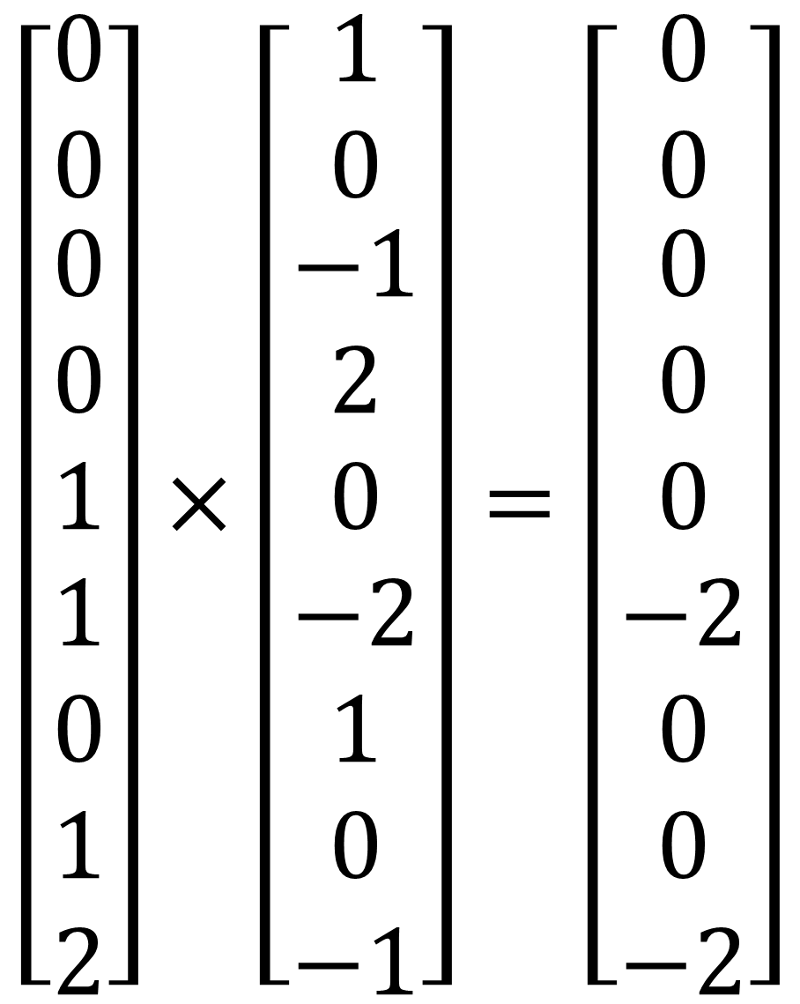
CNN is a spatial-invariant, parameter-sharing FC
Use the convolution operation for spatial invariant → spatial invariant
Use the same filter for the whole image → parameter sharing
1 | 0 | -1
2 | 0 | -2
1 | 0 | -1
$$\left[\begin{matrix}0 \\ 0 \\ \begin{aligned}0 \\ 0 \\ 1 \\ 1 \\ 0 \\ 1 \\ 2\end{aligned}\end{matrix}\right]×\left[\begin{matrix}1 \\ 0 \\ \begin{aligned}−1 \\ 2 \\ 0 \\ −2 \\ 1 \\ 0 \\ −1\end{aligned}\end{matrix}\right]=\left[\begin{matrix}0 \\ 0 \\ \begin{aligned}0 \\ 0 \\ 0 \\ −2 \\ 0 \\ 0 \\ −2\end{aligned}\end{matrix}\right]$$
0 | 0 | 0 | 0 | 0 | 0 | 0 | 0
0 | 1 | 1 | 1 | 1 | 1 | 1 | 0
0 | 1 | 2 | 2 | 2 | 2 | 1 | 0
0 | 1 | 2 | 3 | 3 | 2 | 1 | 0
0 | 1 | 2 | 3 | 3 | 2 | 1 | 0
0 | 1 | 2 | 2 | 2 | 2 | 1 | 0
0 | 1 | 1 | 1 | 1 | 1 | 1 | 0
0 | 0 | 0 | 0 | 0 | 0 | 0 | 0
-4
sum(.)

Slide 8
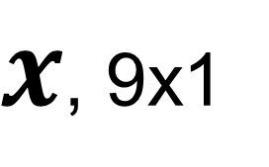
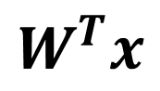
CNN is a spatial-invariant, parameter-sharing FC
Use the convolution operation for spatial invariant → spatial invariant
Use the same filter for the whole image → parameter sharing
1 | 0 | -1
2 | 0 | -2
1 | 0 | -1
0 | 0 | 0 | 0 | 0 | 0 | 0 | 0
0 | 1 | 1 | 1 | 1 | 1 | 1 | 0
0 | 1 | 2 | 2 | 2 | 2 | 1 | 0
0 | 1 | 2 | 3 | 3 | 2 | 1 | 0
0 | 1 | 2 | 3 | 3 | 2 | 1 | 0
0 | 1 | 2 | 2 | 2 | 2 | 1 | 0
0 | 1 | 1 | 1 | 1 | 1 | 1 | 0
0 | 0 | 0 | 0 | 0 | 0 | 0 | 0
$x$, 9x1
-4
$$W^{T}x$$
Take a neighborhood and flatten
Multiple with kernel and sum it up
Can be seen as a local FC

Slide 9
CNN is a spatial-invariant, parameter-sharing FC
Use the convolution operation for spatial invariant → spatial invariant
Use the same filter for the whole image → parameter sharing
1 | 0 | -1
2 | 0 | -2
1 | 0 | -1
0 | 0 | 0 | 0 | 0 | 0 | 0 | 0
0 | 1 | 1 | 1 | 1 | 1 | 1 | 0
0 | 1 | 2 | 2 | 2 | 2 | 1 | 0
0 | 1 | 2 | 3 | 3 | 2 | 1 | 0
0 | 1 | 2 | 3 | 3 | 2 | 1 | 0
0 | 1 | 2 | 2 | 2 | 2 | 1 | 0
0 | 1 | 1 | 1 | 1 | 1 | 1 | 0
0 | 0 | 0 | 0 | 0 | 0 | 0 | 0
$x$, 9x1
-4 | -1
$$W^{T}x$$

Slide 10
CNN is a spatial-invariant, parameter-sharing FC
Use the convolution operation for spatial invariant → spatial invariant
Use the same filter for the whole image → parameter sharing
1 | 0 | -1
2 | 0 | -2
1 | 0 | -1
0 | 0 | 0 | 0 | 0 | 0 | 0 | 0
0 | 1 | 1 | 1 | 1 | 1 | 1 | 0
0 | 1 | 2 | 2 | 2 | 2 | 1 | 0
0 | 1 | 2 | 3 | 3 | 2 | 1 | 0
0 | 1 | 2 | 3 | 3 | 2 | 1 | 0
0 | 1 | 2 | 2 | 2 | 2 | 1 | 0
0 | 1 | 1 | 1 | 1 | 1 | 1 | 0
0 | 0 | 0 | 0 | 0 | 0 | 0 | 0
$x$, 9x1
-4 | -1 | 0
$$W^{T}x$$

Slide 11
CNN is a spatial-invariant, parameter-sharing FC
Use the convolution operation for spatial invariant → spatial invariant
Use the same filter for the whole image → parameter sharing
1 | 0 | -1
2 | 0 | -2
1 | 0 | -1
0 | 0 | 0 | 0 | 0 | 0 | 0 | 0
0 | 1 | 1 | 1 | 1 | 1 | 1 | 0
0 | 1 | 2 | 2 | 2 | 2 | 1 | 0
0 | 1 | 2 | 3 | 3 | 2 | 1 | 0
0 | 1 | 2 | 3 | 3 | 2 | 1 | 0
0 | 1 | 2 | 2 | 2 | 2 | 1 | 0
0 | 1 | 1 | 1 | 1 | 1 | 1 | 0
0 | 0 | 0 | 0 | 0 | 0 | 0 | 0
$x$, 9x1
-4 | -1 | 0 | 0
$$W^{T}x$$

Slide 12
CNN is a spatial-invariant, parameter-sharing FC
Use the convolution operation for spatial invariant → spatial invariant
Use the same filter for the whole image → parameter sharing
1 | 0 | -1
2 | 0 | -2
1 | 0 | -1
0 | 0 | 0 | 0 | 0 | 0 | 0 | 0
0 | 1 | 1 | 1 | 1 | 1 | 1 | 0
0 | 1 | 2 | 2 | 2 | 2 | 1 | 0
0 | 1 | 2 | 3 | 3 | 2 | 1 | 0
0 | 1 | 2 | 3 | 3 | 2 | 1 | 0
0 | 1 | 2 | 2 | 2 | 2 | 1 | 0
0 | 1 | 1 | 1 | 1 | 1 | 1 | 0
0 | 0 | 0 | 0 | 0 | 0 | 0 | 0
$x$, 9x1
-4 | -1 | 0 | 0 | 1
$$W^{T}x$$

Slide 13
CNN is a spatial-invariant, parameter-sharing FC
Use the convolution operation for spatial invariant → spatial invariant
Use the same filter for the whole image → parameter sharing
1 | 0 | -1
2 | 0 | -2
1 | 0 | -1
0 | 0 | 0 | 0 | 0 | 0 | 0 | 0
0 | 1 | 1 | 1 | 1 | 1 | 1 | 0
0 | 1 | 2 | 2 | 2 | 2 | 1 | 0
0 | 1 | 2 | 3 | 3 | 2 | 1 | 0
0 | 1 | 2 | 3 | 3 | 2 | 1 | 0
0 | 1 | 2 | 2 | 2 | 2 | 1 | 0
0 | 1 | 1 | 1 | 1 | 1 | 1 | 0
0 | 0 | 0 | 0 | 0 | 0 | 0 | 0
$x$, 9x1
-4 | -1 | 0 | 0 | 1 | 4
$$W^{T}x$$

Slide 14
CNN is a spatial-invariant, parameter-sharing FC
Use the convolution operation for spatial invariant → spatial invariant
Use the same filter for the whole image → parameter sharing
1 | 0 | -1
2 | 0 | -2
1 | 0 | -1
0 | 0 | 0 | 0 | 0 | 0 | 0 | 0
0 | 1 | 1 | 1 | 1 | 1 | 1 | 0
0 | 1 | 2 | 2 | 2 | 2 | 1 | 0
0 | 1 | 2 | 3 | 3 | 2 | 1 | 0
0 | 1 | 2 | 3 | 3 | 2 | 1 | 0
0 | 1 | 2 | 2 | 2 | 2 | 1 | 0
0 | 1 | 1 | 1 | 1 | 1 | 1 | 0
0 | 0 | 0 | 0 | 0 | 0 | 0 | 0
$x$, 9x1
-4 | -1 | 0 | 0 | 1 | 4
-7
$$W^{T}x$$

Slide 15
CNN is a spatial-invariant, parameter-sharing FC
Use the convolution operation for spatial invariant → spatial invariant
Use the same filter for the whole image → parameter sharing
1 | 0 | -1
2 | 0 | -2
1 | 0 | -1
0 | 0 | 0 | 0 | 0 | 0 | 0 | 0
0 | 1 | 1 | 1 | 1 | 1 | 1 | 0
0 | 1 | 2 | 2 | 2 | 2 | 1 | 0
0 | 1 | 2 | 3 | 3 | 2 | 1 | 0
0 | 1 | 2 | 3 | 3 | 2 | 1 | 0
0 | 1 | 2 | 2 | 2 | 2 | 1 | 0
0 | 1 | 1 | 1 | 1 | 1 | 1 | 0
0 | 0 | 0 | 0 | 0 | 0 | 0 | 0
$x$, 9x1
-4 | -1 | 0 | 0 | 1 | 4
-7 | -4
$$W^{T}x$$

Slide 16
CNN is a spatial-invariant, parameter-sharing FC
Use the convolution operation for spatial invariant → spatial invariant
Use the same filter for the whole image → parameter sharing
1 | 0 | -1
2 | 0 | -2
1 | 0 | -1
0 | 0 | 0 | 0 | 0 | 0 | 0 | 0
0 | 1 | 1 | 1 | 1 | 1 | 1 | 0
0 | 1 | 2 | 2 | 2 | 2 | 1 | 0
0 | 1 | 2 | 3 | 3 | 2 | 1 | 0
0 | 1 | 2 | 3 | 3 | 2 | 1 | 0
0 | 1 | 2 | 2 | 2 | 2 | 1 | 0
0 | 1 | 1 | 1 | 1 | 1 | 1 | 0
0 | 0 | 0 | 0 | 0 | 0 | 0 | 0
$x$, 9x1
-4 | -1 | 0 | 0 | 1 | 4
-7 | -4 | -1 | 1 | 4 | 7
-8 | -7 | -3 | 3 | 7 | 8
-8 | -7 | -3 | 3 | 7 | 8
-7 | -4 | -1 | 1 | 4 | 7
-4 | -1 | 0 | 0 | 1 | 4
$$W^{T}x$$

Slide 17
CNN is a spatial-invariant, parameter-sharing FC
Use the convolution operation for spatial invariant → spatial invariant
Use the same filter for the whole image → parameter sharing
1 | 0 | -1
2 | 0 | -2
1 | 0 | -1
0 | 0 | 0 | 0 | 0 | 0 | 0 | 0
0 | 1 | 1 | 1 | 1 | 1 | 1 | 0
0 | 1 | 2 | 2 | 2 | 2 | 1 | 0
0 | 1 | 2 | 3 | 3 | 2 | 1 | 0
0 | 1 | 2 | 3 | 3 | 2 | 1 | 0
0 | 1 | 2 | 2 | 2 | 2 | 1 | 0
0 | 1 | 1 | 1 | 1 | 1 | 1 | 0
0 | 0 | 0 | 0 | 0 | 0 | 0 | 0
Higher value in outputs indicate “vertical edges”
With direction information (gradient direction)
$x$, 9x1
-4 | -1 | 0 | 0 | 1 | 4
-7 | -4 | -1 | 1 | 4 | 7
-8 | -7 | -3 | 3 | 7 | 8
-8 | -7 | -3 | 3 | 7 | 8
-7 | -4 | -1 | 1 | 4 | 7
-4 | -1 | 0 | 0 | 1 | 4
$$W^{T}x$$

Slide 18
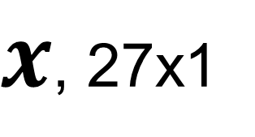

CNN layer with multiple channels
Kernel has multiple channels too
Sum over all channels
Image: $H×W×C$
Kernel: $k_{x}×k_{y}×C$
1 | 0 | -1
2 | 0 | -2
1 | 0 | -1
0 | 0 | 0 | 0 | 0 | 0 | 0 | 0
0 | 1 | 1 | 1 | 1 | 1 | 1 | 0
0 | 1 | 2 | 2 | 2 | 2 | 1 | 0
0 | 1 | 2 | 3 | 3 | 2 | 1 | 0
0 | 1 | 2 | 3 | 3 | 2 | 1 | 0
0 | 1 | 2 | 2 | 2 | 2 | 1 | 0
0 | 1 | 1 | 1 | 1 | 1 | 1 | 0
0 | 0 | 0 | 0 | 0 | 0 | 0 | 0
$x$, 27x1
0
$$W^{T}x$$

Slide 19
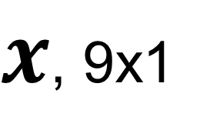
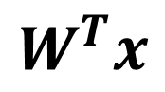
Padding
Pixels on the boundary was not explored
Reduced output size
1 | 0 | -1
2 | 0 | -2
1 | 0 | -1
Padding = 1
 |  |  | 0 | 0 | 0 | 0 | 0 | 0 | 0
 | 0 | 0 | 0 | 0 | 0 | 0 | 0 | 0 | 0
 | 0 | 1 | 1 | 1 | 1 | 1 | 1 | 0 | 0
0 | 0 | 1 | 2 | 2 | 2 | 2 | 1 | 0 | 0
0 | 0 | 1 | 2 | 3 | 3 | 2 | 1 | 0 | 0
0 | 0 | 1 | 2 | 3 | 3 | 2 | 1 | 0 | 0
0 | 0 | 1 | 2 | 2 | 2 | 2 | 1 | 0 | 0
0 | 0 | 1 | 1 | 1 | 1 | 1 | 1 | 0 | 0
0 | 0 | 0 | 0 | 0 | 0 | 0 | 0 | 0 | 0
0 | 0 | 0 | 0 | 0 | 0 | 0 | 0 | 0 | 0
0 | 0 | 0
0
0
-1 | -1 | 0 | 0 | 0 | 0 | 1 | 1
-3 | -4 | -1 | 0 | 0 | 1 | 4 | -3
-4 | -7 | -4 | -1 | 1 | 4 | 7 | -4
-4 | -8 | -7 | -3 | 3 | 7 | 8 | -4
-4 | -8 | -7 | -3 | 3 | 7 | 8 | -4
-4 | -7 | -4 | -1 | 1 | 4 | 7 | -4
-3 | -4 | -1 | 0 | 0 | 1 | 4 | -3
-1 | -1 | 0 | 0 | 0 | 0 | 1 | 1
$x$, 9x1
$$W^{T}x$$
Often pad with 0
Other choices : replica, mirror, periodic

Slide 20
Stride
When sliding the kernel over the image, the moving stepsize is the stride
Default is 1, but stride can be larger than 1
Often used to reduce output size
Stride=2 along row
0 | 0 | 0 | 0 | 0 | 0 | 0 | 0
0 | 1 | 1 | 1 | 1 | 1 | 1 | 0
0 | 1 | 2 | 2 | 2 | 2 | 1 | 0
0 | 1 | 2 | 3 | 3 | 2 | 1 | 0
0 | 1 | 2 | 3 | 3 | 2 | 1 | 0
0 | 1 | 2 | 2 | 2 | 2 | 1 | 0
0 | 1 | 1 | 1 | 1 | 1 | 1 | 0
0 | 0 | 0 | 0 | 0 | 0 | 0 | 0
$x$, 9x1
-4 | -1 | 0
$$W^{T}x$$

Slide 21
Stride
When sliding the kernel over the image, the moving stepsize is the stride
Default is 1, but stride can be larger than 1
Often used to reduce output size
Stride=2 along column
0 | 0 | 0 | 0 | 0 | 0 | 0 | 0
0 | 1 | 1 | 1 | 1 | 1 | 1 | 0
0 | 1 | 2 | 2 | 2 | 2 | 1 | 0
0 | 1 | 2 | 3 | 3 | 2 | 1 | 0
0 | 1 | 2 | 3 | 3 | 2 | 1 | 0
0 | 1 | 2 | 2 | 2 | 2 | 1 | 0
0 | 1 | 1 | 1 | 1 | 1 | 1 | 0
0 | 0 | 0 | 0 | 0 | 0 | 0 | 0
$x$, 9x1
-4
-7
-8
$$W^{T}x$$

Slide 22
Stride
When sliding the kernel over the image, the moving stepsize is the stride
Default is 1, but stride can be larger than 1
Often used to reduce output size
Input 8x8
Kernel 3x3
Output 3x3
With padding=0, stride=2 for H and W
0 | 0 | 0 | 0 | 0 | 0 | 0 | 0
0 | 1 | 1 | 1 | 1 | 1 | 1 | 0
0 | 1 | 2 | 2 | 2 | 2 | 1 | 0
0 | 1 | 2 | 3 | 3 | 2 | 1 | 0
0 | 1 | 2 | 3 | 3 | 2 | 1 | 0
0 | 1 | 2 | 2 | 2 | 2 | 1 | 0
0 | 1 | 1 | 1 | 1 | 1 | 1 | 0
0 | 0 | 0 | 0 | 0 | 0 | 0 | 0
$x$, 9x1
-4 | -1 | 0 | 0 | 1 | 4
-7 | -4 | -1 | 1 | 4 | 7
-8 | -7 | -3 | 3 | 7 | 8
-8 | -7 | -3 | 3 | 7 | 8
-7 | -4 | -1 | 1 | 4 | 7
-4 | -1 | 0 | 0 | 1 | 4
$$W^{T}x$$

Slide 23
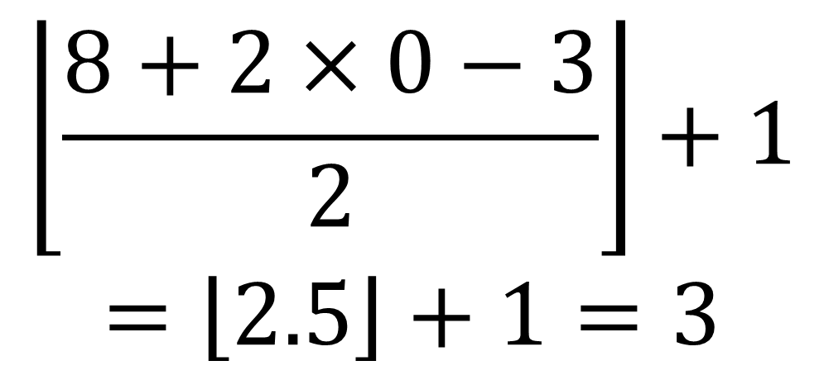
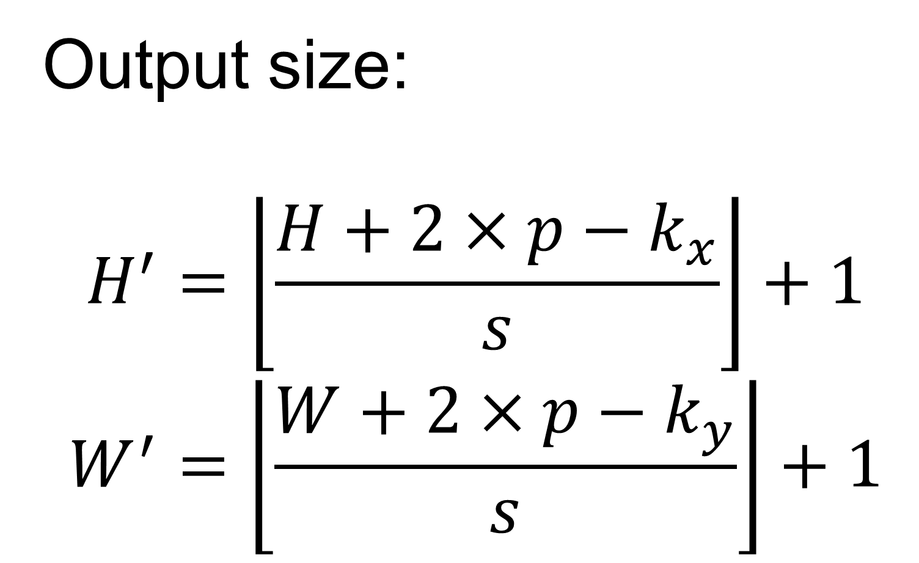
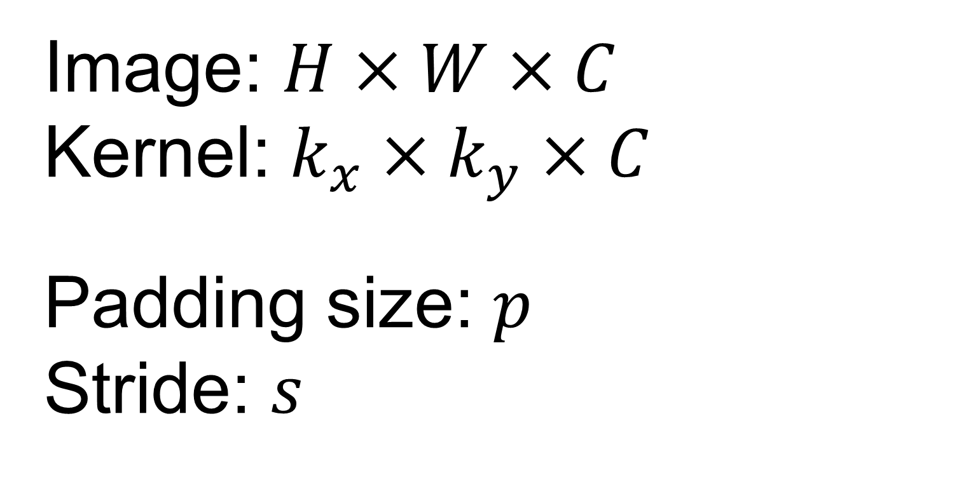
Determine the output size
Output size:
$$H^{′}=\left\lfloor \left.\frac{H+2×p−k_{x}}{s}\right\rfloor \right.+1$$
$$W^{′}=\left\lfloor \left.\frac{W+2×p−k_{y}}{s}\right\rfloor \right.+1$$
Image: $H×W×C$
Kernel: $k_{x}×k_{y}×C$
Padding size: $p$
Stride: $s$
$$\left\lfloor \left.\frac{8+2×0−3}{2}\right\rfloor \right.+1$$
$$=\left\lfloor \left.2.5\right\rfloor \right.+1=3$$
0 | 0 | 0 | 0 | 0 | 0 | 0 | 0
0 | 1 | 1 | 1 | 1 | 1 | 1 | 0
0 | 1 | 2 | 2 | 2 | 2 | 1 | 0
0 | 1 | 2 | 3 | 3 | 2 | 1 | 0
0 | 1 | 2 | 3 | 3 | 2 | 1 | 0
0 | 1 | 2 | 2 | 2 | 2 | 1 | 0
0 | 1 | 1 | 1 | 1 | 1 | 1 | 0
0 | 0 | 0 | 0 | 0 | 0 | 0 | 0
$x$, 9x1
-4 | -1 | 0 | 0 | 1 | 4
-7 | -4 | -1 | 1 | 4 | 7
-8 | -7 | -3 | 3 | 7 | 8
-8 | -7 | -3 | 3 | 7 | 8
-7 | -4 | -1 | 1 | 4 | 7
-4 | -1 | 0 | 0 | 1 | 4
$$W^{T}x$$

Slide 24
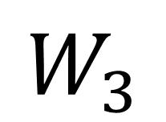
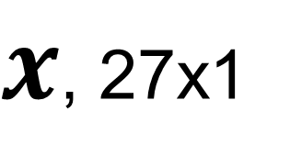
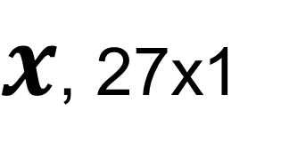
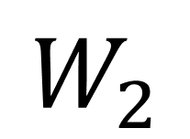
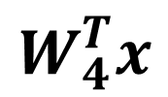
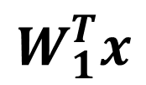
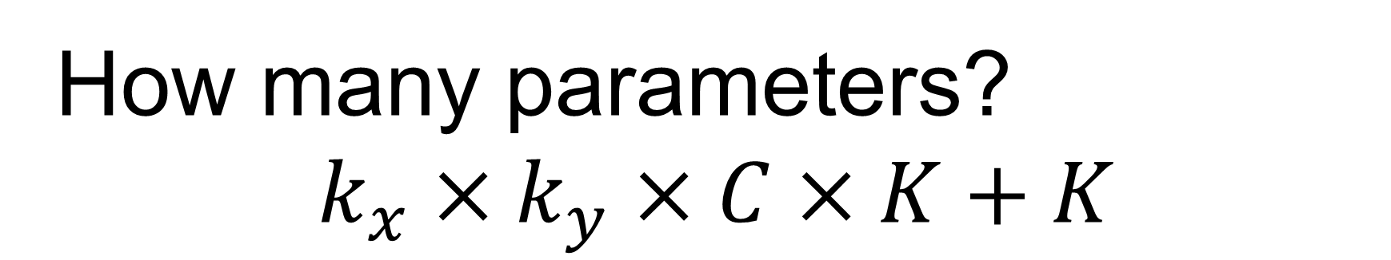
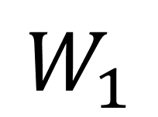
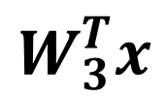
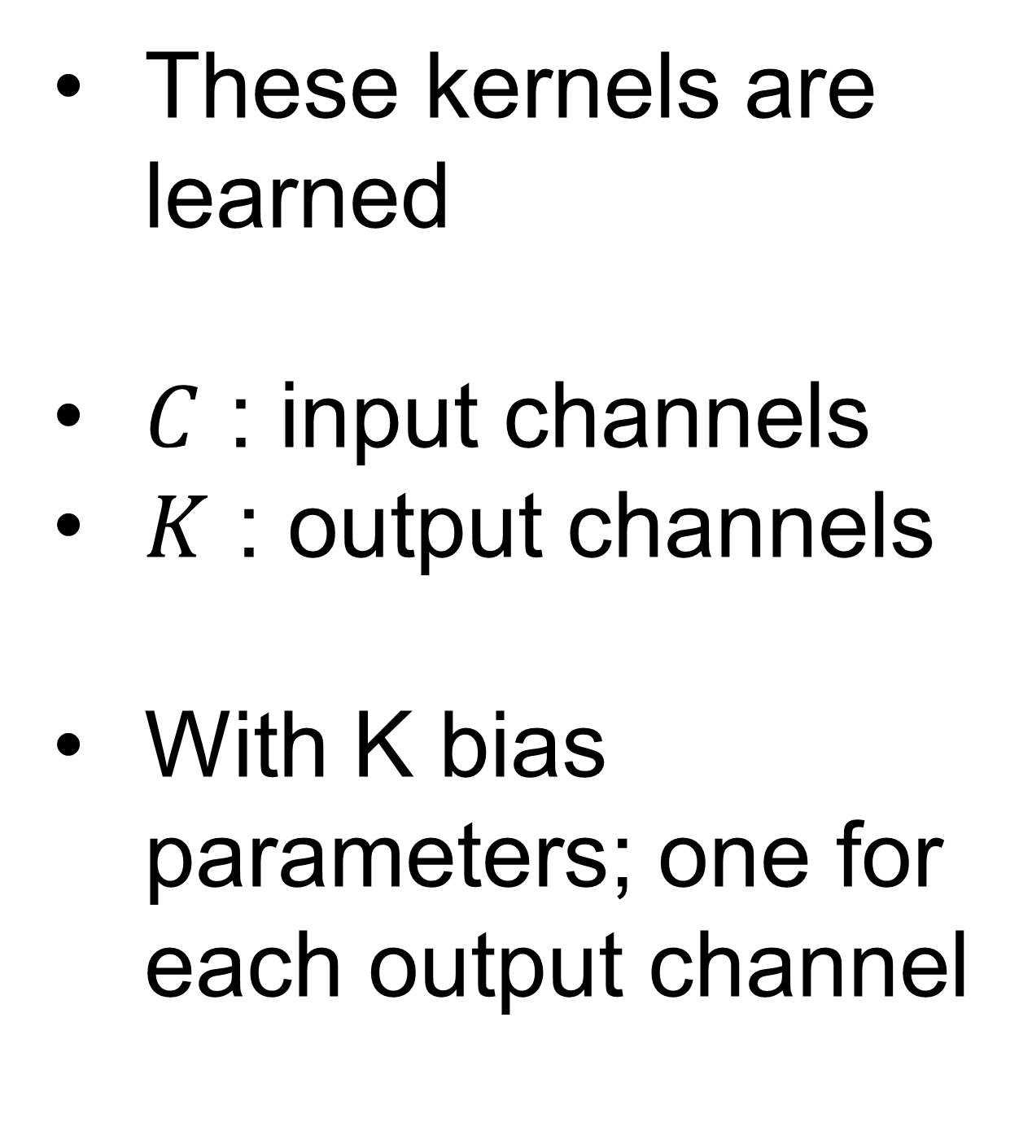
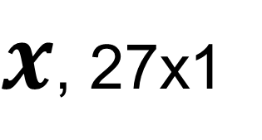
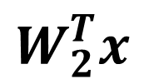
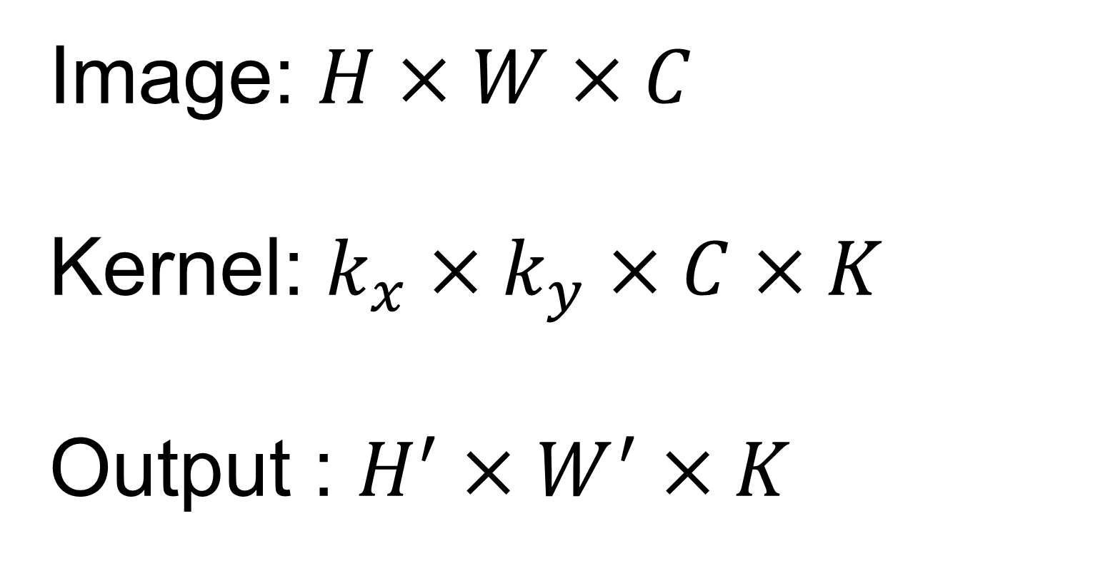
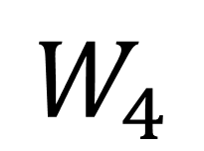
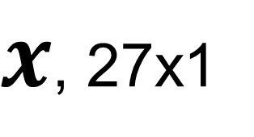
Multiple kernels
For one location in the image, multiple kernels can be used to capture different features
Image: $H×W×C$
Kernel: $k_{x}×k_{y}×C×K$
Output : $H^{′}×W^{′}×K$
1 | 0 | -1
2 | 0 | -2
1 | 0 | -1
1 | 2 | 1
0 | 0 | 0
-1 | -2 | -1
1 | 0 | 0
0 | 1 | 0
0 | 0 | 1
1 | 1 | 0
1 | 0 | 0
0 | 0 | 0
$$W_{1}$$
$$W_{2}$$
$$W_{3}$$
$$W_{4}$$
These kernels are learned
$C$ : input channels
$K$ : output channels
With K bias parameters; one for each output channel
0 | 0 | 0 | 0 | 0 | 0 | 0 | 0
0 | 1 | 1 | 1 | 1 | 1 | 1 | 0
0 | 1 | 2 | 2 | 2 | 2 | 1 | 0
0 | 1 | 2 | 3 | 3 | 2 | 1 | 0
0 | 1 | 2 | 3 | 3 | 2 | 1 | 0
0 | 1 | 2 | 2 | 2 | 2 | 1 | 0
0 | 1 | 1 | 1 | 1 | 1 | 1 | 0
0 | 0 | 0 | 0 | 0 | 0 | 0 | 0
$x$, 27x1
$$W_{1}^{T}x$$
$x$, 27x1
$$W_{2}^{T}x$$
Feature maps
$x$, 27x1
$x$, 27x1
$$W_{3}^{T}x$$
$$W_{4}^{T}x$$
How many parameters?
$$k_{x}×k_{y}×C×K+K$$

Slide 25
Multiple CONV layers can be stacked
Nonlinearity (e.g. ReLU) is applied to every element on feature maps
3x640x480
CONV
7x7, p=3, s=2, K=16
3x640x480
ReLU
3x640x480
logit
CONV
5x5, p=2, s=2 , K=32
FC, D=1
ReLU
ReLU
FC, D=256
CONV
3x3, p=1, s=1 , K=64
ReLU
Flatten

Slide 26
Receptive field
For one location in the image, multiple kernels can be used to capture different features
Image: $H×W×C$
Kernel: $k_{x}×k_{y}×C×K$
Output : $H^{′}×W^{′}×K$
1 | 0 | -1
2 | 0 | -2
1 | 0 | -1
1 | 2 | 1
0 | 0 | 0
-1 | -2 | -1
1 | 0 | 0
0 | 1 | 0
0 | 0 | 1
1 | 1 | 0
1 | 0 | 0
0 | 0 | 0
$$W_{1}$$
$$W_{2}$$
$$W_{3}$$
$$W_{4}$$
These kernels are learned
$C$ : input channels
$K$ : output channels
With K bias parameters; one for each output channel
0 | 0 | 0 | 0 | 0 | 0 | 0 | 0
0 | 1 | 1 | 1 | 1 | 1 | 1 | 0
0 | 1 | 2 | 2 | 2 | 2 | 1 | 0
0 | 1 | 2 | 3 | 3 | 2 | 1 | 0
0 | 1 | 2 | 3 | 3 | 2 | 1 | 0
0 | 1 | 2 | 2 | 2 | 2 | 1 | 0
0 | 1 | 1 | 1 | 1 | 1 | 1 | 0
0 | 0 | 0 | 0 | 0 | 0 | 0 | 0
$x$, 27x1
$$W_{1}^{T}x$$
$x$, 27x1
$$W_{2}^{T}x$$
Feature maps
$x$, 27x1
$x$, 27x1
$$W_{3}^{T}x$$
$$W_{4}^{T}x$$
How many parameters?
$$k_{x}×k_{y}×C×K+K$$

Slide 27
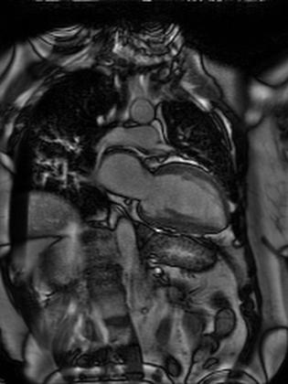
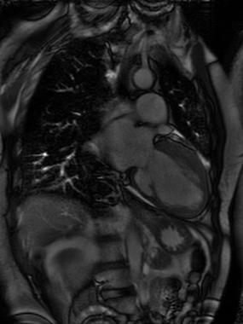
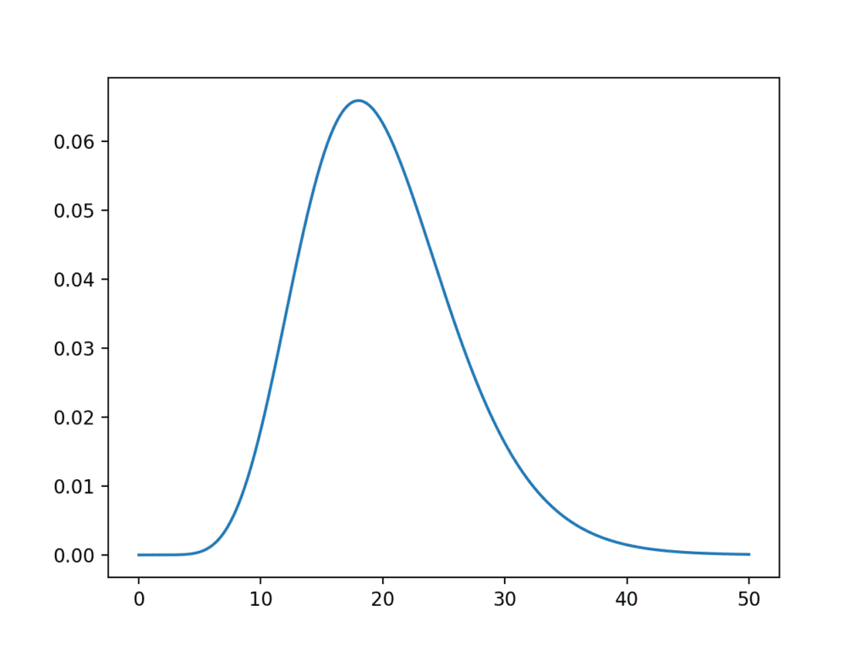
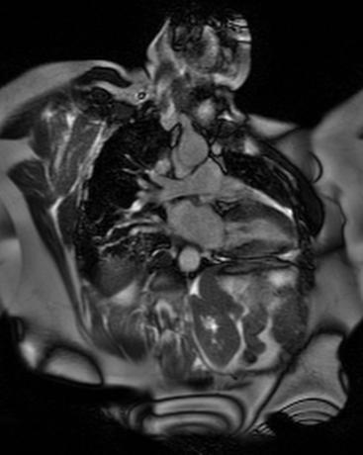
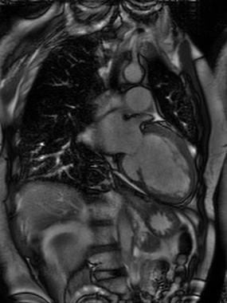
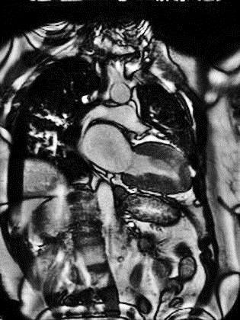
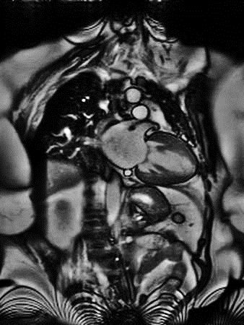
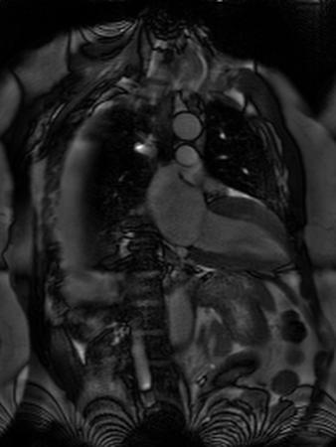
Ideally, Train, Dev, Test sets are from the same data distribution
Train
Dev
Test
Adjust model parameters
Unbiased estimation of model performance
Compare hyper-parameters
Unknown data distribution
Train
Dev
sample
Test
What we care in the end!

Slide 28
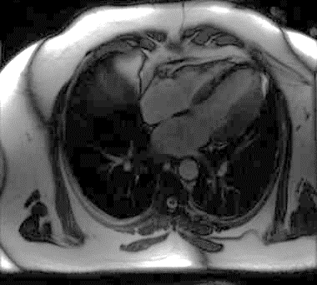
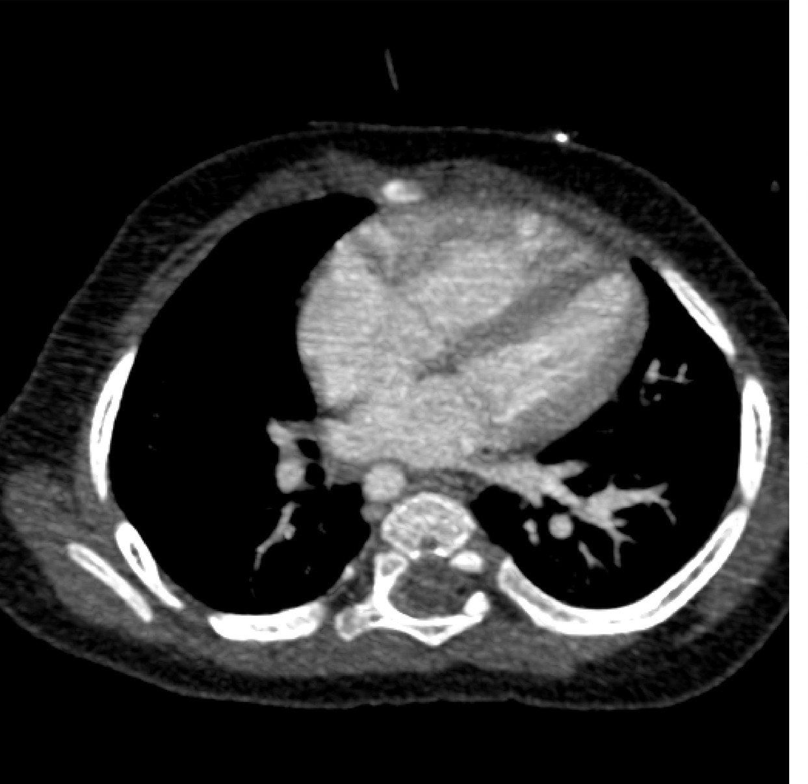
Test and Train sets can be from different distribution
https://www.clinicalradiologyonline.net/article/S0009-9260(17)30058-2/fulltext
10K, MRI images
1K, CT images

Slide 29
Test and Train sets can be from different distribution
Goal: Detect whether heart is imaged in MR images
 | Option1
Train | 8K MRI
Dev | 1K MRI
Test | 1K MRI
Option2
8K MRI+1K CT
1K MRI
1K MRI
Option3 | Option4
8K MRI | 8K MRI
1K MRI+1K CT | 1K MRI
1K MRI | 1K MRI +1K CT
10K, MRI images
1K, CT images

Slide 30
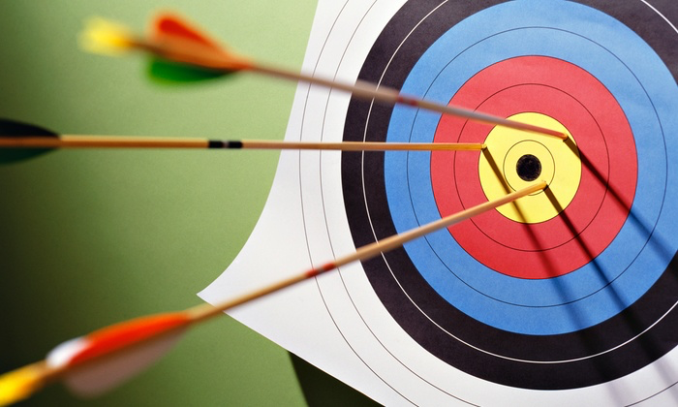
Test and Train sets can be from different distribution
Sample the Dev and Test sets from the same data distribution for the deployment time
10K, MRI images
Dev and Test sets define the target of the model
1K, CT images
https://www.google.com/url?sa=i&url=https%3A%2F%2Ftowardsdatascience.com%2Ftradeoff-bias-or-variance-1409eec38caf&psig=AOvVaw0FzJ-R_8JxUkPlAiJQax7Y&ust=1620153718709000&source=images&cd=vfe&ved=0CAIQjRxqFwoTCMCroImVrvACFQAAAAAdAAAAABAD

Slide 31
Test and Train sets can be from different distribution
Goal: Detect whether heart is imaged in CT images
 | Option1
Train | 500 CT
Dev | 250 CT
Test | 250 CT
Option2
10K MRI
500 CT
500 CT
Option3
10K MRI+500 CT
250 CT
250 CT
10K, MRI images
1K, CT images

Slide 32
Dev and Train set are from the different distribution
Goal: Detect whether heart is imaged in CT images
Bayes accuracy
Bias
Training accuracy
10K, MRI images
Variance
Dev accuracy
accuracy
Model variance can be overestimated, due to data mismatch
1K, CT images
epoch

Slide 33
Dev and Train set are from the different distribution
Train
Tra-Dev
Dev
Test
Adjust model parameters
Unbiased estimation of model performance
Compare hyper-parameters
Estimate data mismatch error
Split the train set further to get a Tra-Dev set
Train and Tra-Dev set have the same data distribution
Used to estimate model variance

Slide 34
Train, Tra-Dev, Dev and Test sets
Bayes accuracy
Bias
Training accuracy
Variance
TraDev accuracy
Data mismatch
Dev accuracy
Dev set overfitting
accuracy
Test accuracy
epoch

Slide 35
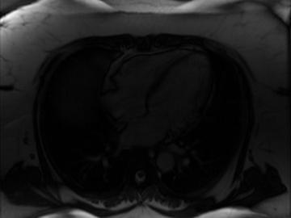
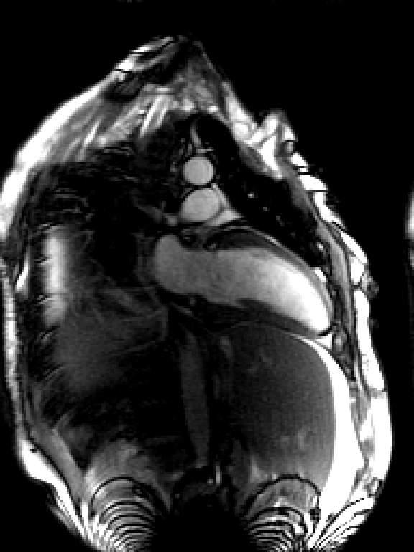
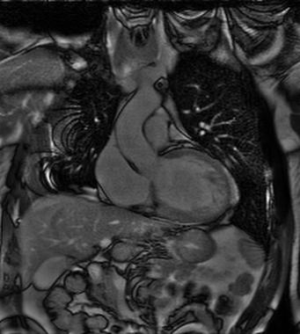
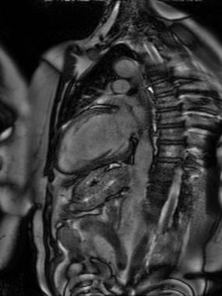
Spot problems : Error analysis
Error analysis : exam the incorrect/less-perfect samples in Dev set to spot the problems
Image is too dark
5%
New image view
11%
Image is flipped and with different contrast
14%
Typical sample in Train set

Slide 36
Spot problems : Error analysis
Error analysis : exam the incorrect/less-perfect samples in Dev set to spot the problems
Findings | Error rate | Remedies
Image is too dark | 5% | Add pre-processing
New image view | 11% | Acquire more data
Image is flipped and with different contrast | 14% | Add data augmentation

Slide 37
Iterate error analysis with training
Training Error | 67%
Dev Error | 65%
Correct for first findings: add data pre-processing, data augmentation, add new data
Training Error | 87%
Dev Error | 77%
Increase model depth + L2 Reg
Training Error | 95%
Dev Error | 94%
Second error analysis
Human-level-performance: ~ 100% detection rate
Iterative process
The key for deep learning is to decide what to do at each step
… …
Until meet the performance requirement

Slide 38
Speedup the error analysis
Eyeball set: a portion of dev set to check
Blackbox set: a portion of dev set to apply model, but not exam for error

Slide 39

Active selection
Use the model output to pick samples to check
Consider to use different metrics
Combine domain knowledge, e.g. signal-noise-ratio in different imaging protocols, image appearances in different diseases (such as hypertrophic cardiomyopathy)
Automate this process and optimize tools

Slide 40
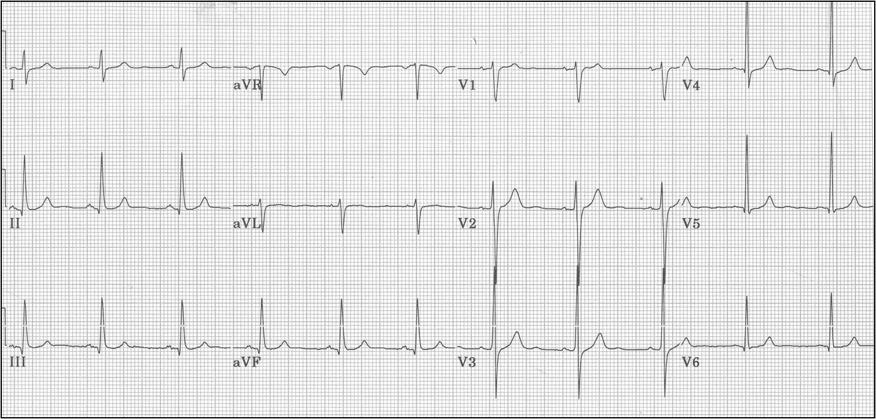
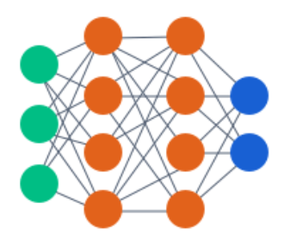
Error analysis of a complex system
R-R interval, location of S-T wave
https://ecg.utah.edu/lesson/3
Model 1
Disease classification
Model 3
Segmentation of heart
Model 2

Slide 41
Error analysis of a complex system
Manually labeled R-wave
https://ecg.utah.edu/lesson/3
Model 1
Disease classification
Model 3
Manual segmentation
Model 2

Slide 42
Error analysis of a complex system
https://ecg.utah.edu/lesson/3
Model 1
Disease classification
Model 3
Manual segmentation
Model 2

Slide 43
Error analysis of a complex system
Manual label
https://ecg.utah.edu/lesson/3
Model 1
Disease classification
Model 3
Model 2

Slide 44
Error analysis of a complex system
Latent representation, Nx1
https://ecg.utah.edu/lesson/3
Model 1
Disease classification
Model 3
Debug as one big model
End-to-end training
Harder to isolate bugs
Latent representation, Tx1
Model 2

Slide 45
Outline
Set up the training, cont.
Data pre-processing
Model weight initialization
Tips for model training

Slide 46
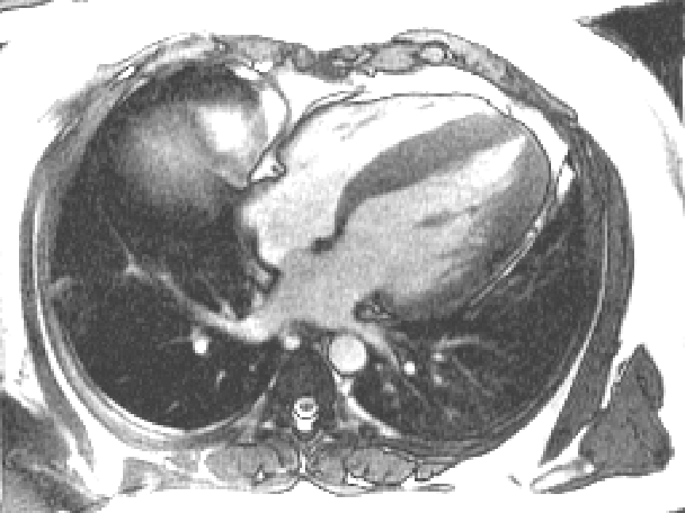

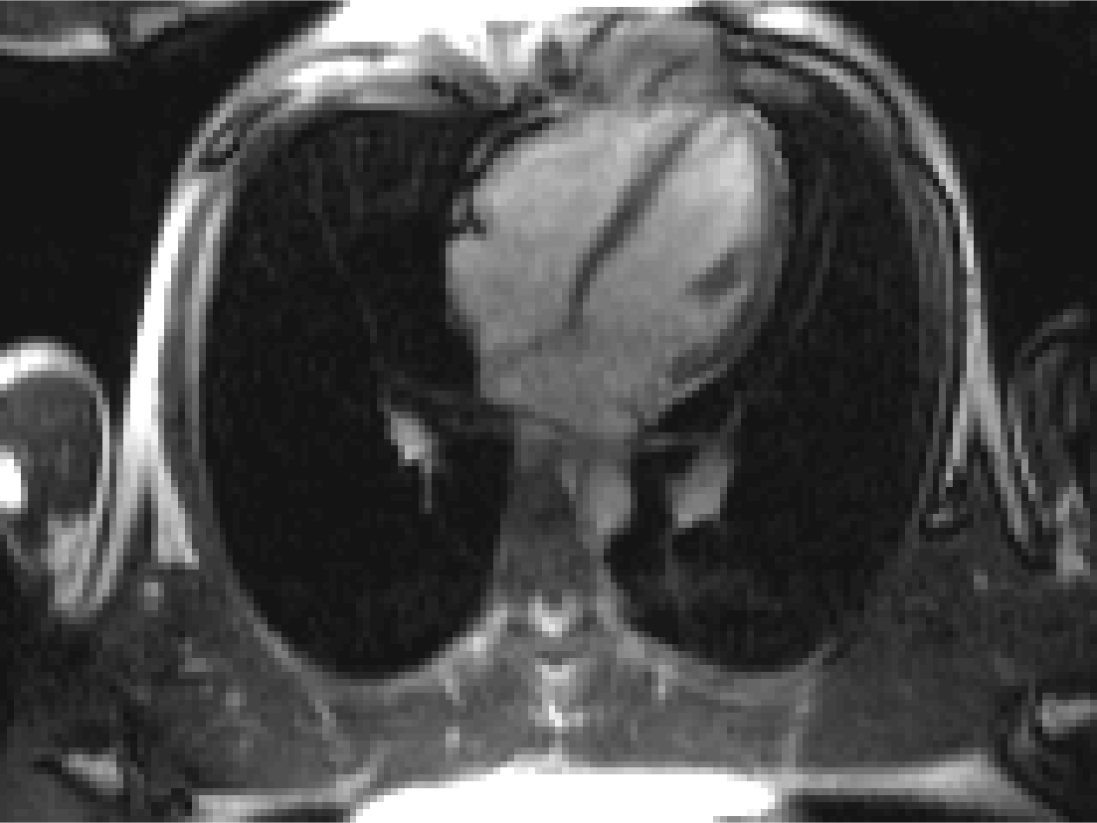
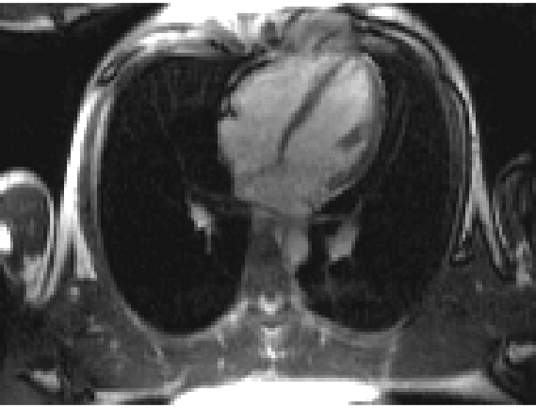




Data pre-processing to reduce variation
Standardizing the input data and reducing the variation can help training
Resample to fixed resolution
High spatial resolution
Low spatial resolution
Fixed high resolution of 1mm²
Adjust image windowing

Slide 47



Data pre-processing to understand
Understand the “edge” samples, exclude the corrupted samples and correct wrong labels
An average of 3.4% errors across the 10 benchmark ML datasets
Has impact on evaluating different models
Noisy with artifacts
Signal loss due to devices
https://labelerrors.com/
https://l7.curtisnorthcutt.com/confident-learning

Slide 48
Data pre-processing
Normalize different dimension of input data, help optimization
Features with varying magnitude
After scaling and centering

Slide 49


Scale and centering
Normalize different dimension of input data, help optimization
$$X∈ℝ^{N×2}$$
$$X=X−np.mean(X, axis=0)$$
$$X=\frac{X−np.mean\left(X, axis=0\right)}{np.std(X, axis=0)}$$
Another approach often used: $X=\frac{X−np.mean\left(X, axis=0\right)}{np.amax\left(X, axis=0\right)−np.amin(X, axis=0)}$

Slide 50


PCA: Principal Component Analysis
diagonal
$$X∈ℝ^{N×2}$$
$$X=X−np.mean(X, axis=0)$$
$$\left[D, V\right]=np.linalg.eig\left(np.dot\left(X.T, X\right)/N\right)$$
$$X=np.dot(X, V)$$
$$X=X/{np.sqrt(X∙diagonal())}$$

Slide 51


PCA: Principal Component Analysis
$$X∈ℝ^{N×D}$$
If the input dimension D is large, dimension reduction can be performed
$$\left[D, V\right]=np.linalg.eig\left(np.dot\left(X.T, X\right)/N\right)$$
$$X=np.dot\left(X, V\right)$$
$$X=X[:,0:K]$$
Only keep the top K dimension, $X∈ℝ^{N×K}$, can filter out some noise
These steps are also called “Whitening” :
the covariance matrix of X after applying the eigenvector and divided by sqrt(eigenvalue) becomes identity matrix

Slide 52

Tips for data processing
For image, often only apply centering and scaling
$$X=\frac{X−np.mean\left(X, axis=0\right)}{np.amax\left(X, axis=0\right)−np.amin(X, axis=0)}$$
Or simply, X=X/np.max(X) ← scale image to be [0, 1]
For time signal or multi-channel signals, PCA can be useful
Start simple and plot results from every preprocessing steps
Including the preprocessing in the regression test
Make sure the inference data go through the identical pre-processing steps
Computing the pre-processing statistics (e.g. dataset mean, eigen vectors, eigen values …) on the training set ONLY and applying them in inference
Complicated pre-processing can make model more vulnerable to data distribution shift

Slide 53
Outline
Set up the training, cont.
Data pre-processing
Model weight initialization
Tips for model training

Slide 54








Need a strategy to give weights some initial values
W₁^{[1]}
f
$$Z^{[1]}=W^{\left[1\right]}X+b^{[1]}$$
W₁^{[2]}
f
$$a^{[1]}=f(Z^{\left[1\right]})$$
$$X$$
W₂^{[1]}
f
W₁^{[3]}
f
$$a^{[3]}$$
$$Z^{[2]}=W^{\left[2\right]}X+b^{[2]}$$
$$a^{[2]}=f(Z^{\left[2\right]})$$
W₂^{[2]}
f
$$Z^{[3]}=W^{[3]}a^{[2]}+b^{[3]}$$
f
$${\hat{y}=a}^{[3]}=f(Z^{\left[3\right]})$$
W₃^{[1]}
How do we initialize weights and biases?

Slide 55







Need a strategy to give weights some initial values
How about W=0 and b=0?
$$Z^{[1]}=W^{\left[1\right]}X+b^{[1]}$$
All $Z^{[l]}$ will be zero
All $a^{[l]}$ will be a constant, depending on the non-linear activation function used
When performing backprop, then gradient will be zero …
So SGD cannot update network parameters …
$$a^{[1]}=f(Z^{\left[1\right]})$$
$$Z^{[2]}=W^{\left[2\right]}a^{[1]}+b^{[2]}$$
$$a^{[2]}=f(Z^{\left[2\right]})$$
$$Z^{[3]}=W^{[3]}a^{[2]}+b^{[3]}$$
$${\hat{y}=a}^{[3]}=f(Z^{\left[3\right]})$$

Slide 56


Need a strategy to give weights some initial values
How about W=$σ×$np.random.rand(input_D, output_D), zero-mean, gaussian random values
$$Z^{[1]}=W^{\left[1\right]}X+b^{[1]}$$
$W^{\left[1\right]}:$3xN matrix
$$Z_{k}^{[1]}=\sum_{i=0}^{N−1}{W_{k,i}^{[1]}x_{i}}+b^{[1]}$$
The k-th element of score Z
Let’s whitening the input X, so it has same variance for all features.
${Var(Z}_{k}^{[1]})=\sum_{i=0}^{N−1}{{Var((W}_{k,i}^{[1]})Var(x_{i})}+{Var(b}^{[1]})=Nσ^{2}$ $Var(x)$
Since all $x_{i}$ and $W_{k,i}^{[1]}$ are independent upon initialization, with zero mean
$Var\left(wx\right)=E\left(w^{2}\right)E\left(x^{2}\right)−{E(w)}^{2}$ ${E(x)}^{2}=E\left(w^{2}\right)E\left(x^{2}\right)=Var\left(w\right)Var(x)$
If w and x are independent and have zero mean

Slide 57





For deep network, activation function can be saturated
$σ$=0.01
$σ$=0.05
tanh activation was used
Figure credit: Stanford CS231N notes

Slide 58



Xavier Initialization
${Var(Z}_{k}^{[1]})=Nσ^{2}$ $Var(x)$
For a deep network, the non-linear activation can be saturated for native initialization
Make the learning harder
Sensitive to hyperparameter configuration
To keep the output variance unchanged:
W=np.random.rand(output_D, input_D)/np.sqrt(input_D)
$$σ=\frac{1}{\sqrt{N}}$$
$${Var(Z}_{k}^{[1]})=\sum_{i=0}^{N−1}{{Var((\frac{1}{\sqrt{N}}W}_{k,i}^{[1]})Var(x_{i})}+{Var(b}^{[1]})=Var(x)$$
Xavier Glorot and Yoshua Bengio, “Understanding the difficulty of training deep feedforward neural networks”, AISTAT 2010

Slide 59

He initialization: Xavier Initialization for ReLU activation
W=np.random.rand(output_D, input_D) × 2/np.sqrt(input_D)
$$σ=\frac{2}{\sqrt{N}}$$
To compensate the ReLU function for the negative inputs
$Var\left(wx\right)=E\left(w^{2}\right)E\left(x^{2}\right)−{E(w)}^{2}$ ${E(x)}^{2}=E\left(w^{2}\right)E\left(x^{2}\right)=Var\left(w\right)E\left(x^{2}\right)=\frac{1}{2}Var\left(w\right)Var\left(x\right)$
x is the response after RELU, which has positive mean
Use Xavier or He initialization
Bias is initialized to zero; randomness in weights often is sufficient to drive the training
With Batch Normalization, network training is much less sensitive to parameter initialization
He et al, “Delving Deep into Rectifiers: Surpassing Human-Level Performance on ImageNet Classification”, ICCV 2015

Slide 60

He initialization: Xavier Initialization for ReLU activation
$Var\left(wx\right)=E\left(w^{2}\right)E\left(x^{2}\right)−{E(w)}^{2}$ ${E(x)}^{2}=E\left(w^{2}\right)E\left(x^{2}\right)=Var\left(w\right)E\left(x^{2}\right)=\frac{1}{2}Var\left(w\right)Var\left(x\right)$
x is the activation after RELU, which has positive mean
y is the score before ReLU:
x = max(0, y)
y has zero-mean and symmetric distribution,
if the network is in good condition before this layer
https://stats.stackexchange.com/questions/138035/variance-calculation-relu-function-deep-learning

Slide 61
Outline
Set up the training, cont.
Data pre-processing
Model weight initialization
Tips for model training

Slide 62
Debug deep neural network model can be difficult
Initial decision
Model
architecture
Evaluation
Bias-Variance analysis
Adjustment, model and data
Implementation
Implementation
Iteration
often slow
Model
performance
Datasets
How the
training is conducted
Hyperparameter
searching
deployment
Influenced by several factors

Slide 63

Before you started …
Elo rating
Have an estimation of Bayes accuracy
Human level performance as a surrogate
Expert performance – experienced operators vs. less experienced
Voting strategy
Baseline and results from publications
Whether it has related competition
https://www.drdobbs.com/parallel/computer-chess-the-drosophila-of-ai/184405171

Slide 64

Before you started …
Have the Dev and Test set established
Dev and test sets should be large enough to give a reliable estimation of model performance
If the total amount of data is small, get more data and use cross-validation
https://machinelearningmastery.com/learning-curves-for-diagnosing-machine-learning-model-performance/

Slide 65


Before you started …
Have the evaluation metric
Accuracy, Dice ratio, L2 distance, business specific metrics?
Pick the key metric
Accuracy=(TP+TN)/(TP+TN+FP+FN)
Precision=TP/(TP+FP)
Sensitivity=TP/(TP+FN)
Specificity=TN/(TN+FP)
F1 score=2 x Pre x Sen / (Precision+Sensitivity)
https://towardsdatascience.com/confusion-matrix-for-your-multi-class-machine-learning-model-ff9aa3bf7826

Slide 66

Before you started …
Have the expectation
Know when to stop
Be the state-of-the-art?
Meet the business needs?
Consider the resource limitation
Data and computing
90% and 90.2% may be the same for your deployment
https://paperswithcode.com/sota/image-classification-on-imagenet

Slide 67
Model architecture
Start from standard choices and make changes if needed
Look for available resources
Look for related publications
Read the code if possible and do not take it blindly
Tasks | First try
Image classification | Standard ResNet, e.g. implementation in Pytorch repo
Segmentation | Unet architecture
Language, NLP | Pre-trained GPT family models
Time series signal | Bidirectional RNN with LSTM
Tabular data | Dense MLP, DropOut, BatchNorm

Slide 68


Implementation
Pay attention to output layers
With the same base network, different functionalities can be achieved by changing the output layers:
Pooling and dense linear for classification
CONV layer for segmentation
Dense linear for regression
Pay attention to loss function – need logits or need probabilities?
different implementation may pack extra computation into loss function

Slide 69
Overfit a small dataset, e.g. one mini-batch
For classification, accuracy should quickly reach 100%
For segmentation, Dice ratio should quickly increase to ~1.0
Very useful to find implementation bugs:
Loss goes up
learning rate too high, error in output layer for class order…
Loss is NaN
Overflow or underflow or divided-by-zero
Accuracy plateaus
learning rate too low, bad initialization, regularization too high, data/label mismatch …
Train
Dev

Slide 70

Check the initial loss function, if making sense
These nodes will give roughly same scores for every class
Random initialized
All output classes are treated equally
For the binary classification, initial loss will be close to –log(0.5)
For the multi-class classification, initial loss will be close to –log(1/C), C is the number of total class

Slide 71


First turn off regularization/drop out/Batch Norm
$$L=\frac{1}{B}\sum_{i=0}^{B−1}{L^{\left(i\right)}}+\frac{λ}{2}{\left\|W\right\|}_{2}^{2}$$
Set $λ=0$ to begin with
Maker sure regularization loss not dominate total loss
Turn off operations to introduce randomness to training, e.g. drop out
Add controls to allow turn them on/off easier
Consider to turn off batch norm at first trials, since BN layer can hide problem such as NaN in computation, explosion/vanishing gradients, and make debug harder
With BatchNorm, make sure Batch size large enough (>16)

Slide 72



Check every steps, starting from pre-processing
Errors can happen in pre-processing, such as
forget to change label after processing images (e.g. image scaling for segmentation)
Errors can happen in datasets:
forget the shuffle the samples, some samples are corrupted …
Errors can happen when loading data:
image/label mismatch
L2 norm of all samples
Some images are blanket!
Scale the image and forget to scale mask

Slide 73


Check immediate inputs to your model training code
Print/plot/save a few mini-batch and check them before training
Batch A
Batch B

Slide 74

Check immediate outputs of your model before any post-processing
scores = model(images)
Goal : detect key landmarks
Model outputs are spatial probability maps
Postprocessing: extract landmark location

Slide 75

Add Debug mode and verbose mode, add working_dir
Easily enable or disable
Fast, not slow down training if disabled
Save intermediate results with its index/name/time stamp/data role …
Keep these code lines in your repo

Slide 76


Monitor the learning curves
Loss is not decreasing quickly
learning rate too low
model underfitting
try to fix the problem by fitting to a tiny dataset
https://machinelearningmastery.com/learning-curves-for-diagnosing-machine-learning-model-performance/

Slide 77

Monitor the learning curves
Loss goes up for dev set and goes down for training set
model overfitting
add regularization
reduce mode capacity
add more training data

Slide 78

Monitor the learning curves
Loss shows strong variance in dev set
model overfitting
training set too small
Add more sample to training set

Slide 79

Monitor the learning curves
Loss is lower for dev set than train set
dev set is easier than train set
too much data augmentation
dev/tra set distribution mismatch
exam dev set

Slide 80


Monitor the learning curves
Good training
Accuracy is high, but still increasing
Consider to train longer
Note with one-cycle scheduler, at high LR, the accuracy can dip

Slide 81



Use Debugger
Tensor shape mismatch
Loss function exceptions
Nan or inf error
All other exceptions …
set breakpoints
check variable values
interactive debugging
… …
or, pdb or ipdb for CLI experiences of debugging

Slide 82


Use Experimental management tools
My model is finally good,
but I forget how it was trained !
Record your training and parameters
Integrated with python training code
Support hyperparameter searching
Easy to compare different experiments
Many iterations may be needed to reach required performance

Slide 83
Do not use hyperparameter searching as the first remedy
Bias-Variance analysis
Initial decision
Evaluation
Bias-Variance analysis
Adjustment, model and data
Implementation
Fix bias
Start hyperparameter searching after fixing obvious bias/variance problems
Often large performance gain is from error analysis and collecting specific new data for problems found
Fix bias/variance problems can change model and which hyperparameters to tune
Iteration
Fix variance
Fix train/dev
data mismatch
Hyperparameter
searching
deployment
Has
new issues?
Yes
No

